Slide 1

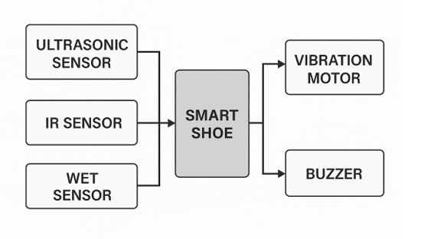
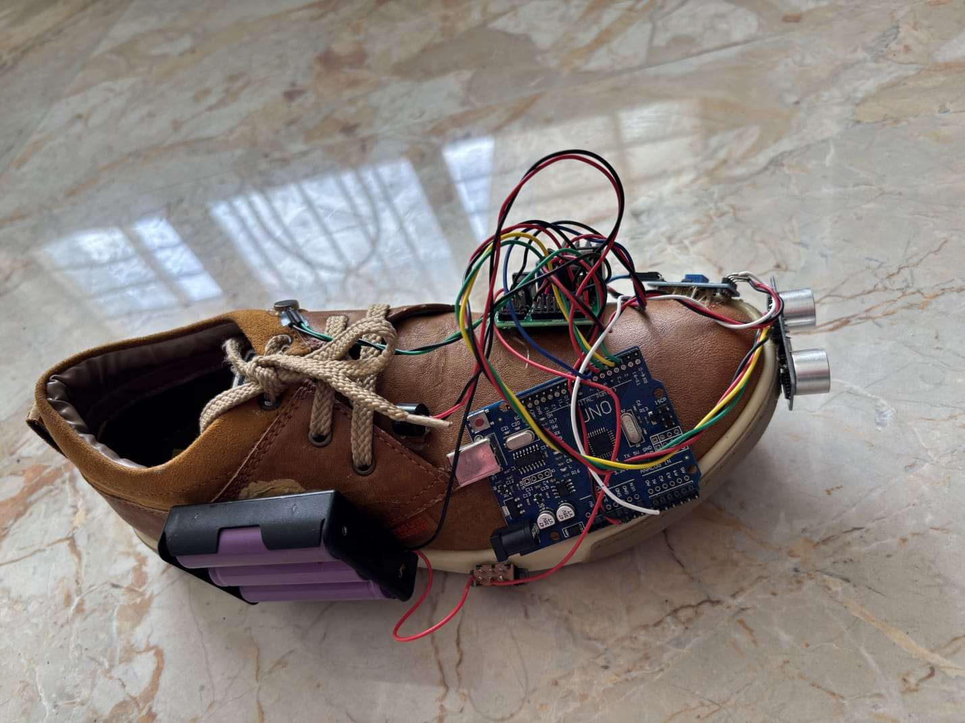
School of Engineering and Technology
Department of Computer Science and Engineering
HARDWARE PROJECT EXPO
TITLE OF THE PROJECT: “SHOEBOT FOR VISUALLY IMPAIRED PEOPLE”
ABSTRACT
METHODOLOGY & SPECIFICATION
This project presents SHOEBOT, a smart shoe system for visually impaired people, integrating ultrasonic, IR, and wet sensors with real-time buzzer and vibration alerts. The shoe detects obstacles, stairs, and wet surfaces to improve mobility and safety. Tested successfully in various environments, it offers a low-cost, wearable solution for independent, confident navigation.
Arduino-based smart shoe with ultrasonic, IR, and wet sensors.
Detects obstacles (up to 30 cm), stairs, and wet surfaces in real-time.
Alerts via buzzer (sound) and vibration motor (touch).
Powered by a 5V rechargeable battery.
Programmed with Arduino IDE for continuous sensor monitoring and quick alerts.
ABSTRACT:
PROJECT DIAGRAM
APPLICATIONS & ADVANTAGES
OPEN POSITIONS
APPLICATIONS:
Safe walking for visually impaired people on streets, sidewalks, and crowded places.
Navigation assistance in homes, offices, schools, and public buildings.
Extra safety in wet or slippery environments like bathrooms, kitchens, and rainy outdoor areas.
Training tool for mobility classes or rehabilitation programs for newly visually impaired individuals.
Early warning system for elderly people prone to falls.
ADVANTAGES:
Real-time obstacle and wet surface alerts.
Affordable, wearable, and easy to use.
Enhances confidence and independence.
Website Designer
Graphic Designer
Project Manager
3D Illustrator
Video Editor
PROJECT GUIDE:AFROZ PASHA
FUTURE SCOPE
PROJECT TEAM (SECTION: EC-32):
SHRAVYA V (24SUUBECS1991)
SHRAVYA D (24SUUBECS1989)
SHRAVANI KULKARNI (24SUUBECS1985)
SHREEMATA BHAT (24SUUBECS1995)
SHIVANANDA M SHET (24SUUBECS1977)
SHREYA BIRADER (24SUUBECS2002)
FUTURE SCOPE:
Add GPS for real-time location tracking and safety.
Integrate Bluetooth to connect with smartphones for SOS alerts.
Include voice guidance for spoken obstacle warnings.
Miniaturize electronics for better comfort and longer battery life.
Make the system waterproof for all-weather use.
Use AI to identify and classify different obstacles for smarter alerts.

